Slide 1
HOO 2012: A Report on the Preposition and Determiner Error Correction Shared Task
Robert Dale, Ilya Anisimoff and George Narroway Centre for Language Technology Macquarie University

Slide 2
Overview
Background: The HOO 2011 Pilot Round
The HOO 2012 Prepositions and Determiners Challenge
Results
Conclusions

Slide 3
What is HOO?
‘Helping Our Own’
We want to use NLP technology to help people write better NLP papers
Initially targeting
non-native speakers
‘superficial’ errors – grammar, style, punctuation

Slide 4
The HOO 2011 Pilot Round Data
~1k word extracts from ACL papers authored by non-native speakers
Texts marked up with an XML variant of the Cambridge Learner Corpus tagset
Development data: 19 extracts
Annotated by two professional copy editors
Test data: 19 extracts from same documents
Annotated by one editor and checked by one organiser

Slide 5
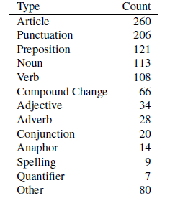
HOO 2011: Errors by Type

Slide 6
HOO 2011: Participation
Google Groups discussion list with 40+ members
6 teams participated in the pilot round
Results presented at European NLG Workshop 2011
See Dale and Kilgarriff [2010, 2011] for details

Slide 7
Overview
Background: The HOO 2011 Pilot Round
The HOO 2012 Prepositions and Determiners Challenge
Results
Conclusions

Slide 8
Preposition Errors
Error Type | Original | Correction
Incorrect Preposition | I could only travel on July | I could only travel in July
Missing Preposition | I am looking forward your reply | I am looking forward to your reply
Unwanted Preposition | I have booked a flight to home | I have booked a flight home

Slide 9
Article Errors
Error Type | Original | Correction
Incorrect Article | wich was situeded on a seaside | wich was situeded on the seaside
Missing Article | I will give you all information | I will give you all the information
Unwanted Article | One of my hobbies is the photography | One of my hobbies is photography

Slide 10
The Data
Focussed only on preposition and article errors
All other errors left uncorrected but not annotated
Training:
1000 exam scripts from the Cambridge Learner Corpus
375 words per script, one error every 44 words
Testing:
100 previously unseen exam scripts
180 words per script, one error every 40 words

Slide 11
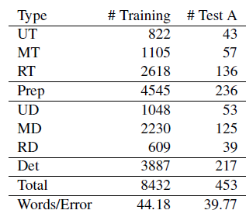
Error Type Breakdown

Slide 12
Overview
Background: The HOO 2011 Pilot Round
The HOO 2012 Prepositions and Determiners Challenge
Results
Conclusions

Slide 13
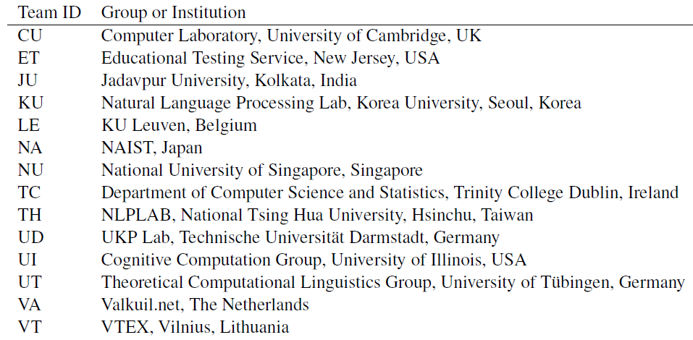
Participation
26 teams registered interest, 14 teams made final submissions

Slide 14
Evaluation Metrics
Scope:
Preps, Dets, Both
Scores:
Detection, Recognition, Correction
Measures:
Precision, Recall, F-Score

Slide 15
Managing Annotation Errors
Teams submitted results (standoff annotations) on test data within one week of test data release
Teams invited to nominate corrections to the test data
Change requests assessed and implemented in the gold standard
Initially submitted results rescored against revised gold standard
Results shown here are before revisions: see paper for numbers after revisions

Slide 16
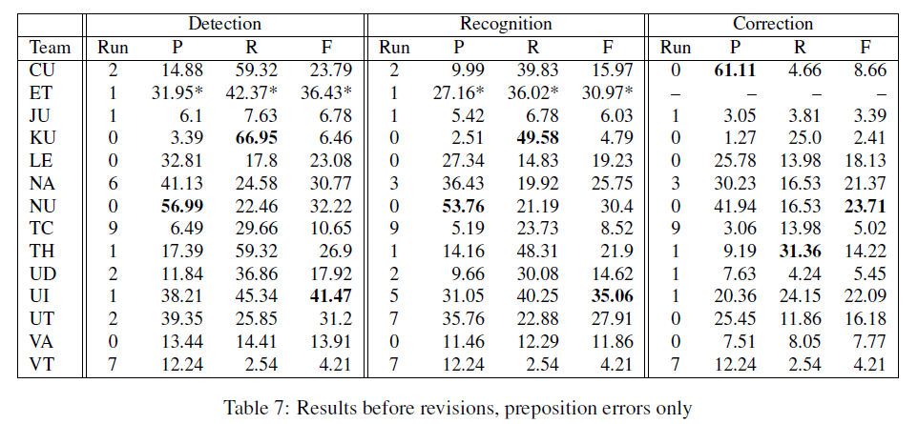
Prepositions

Slide 17
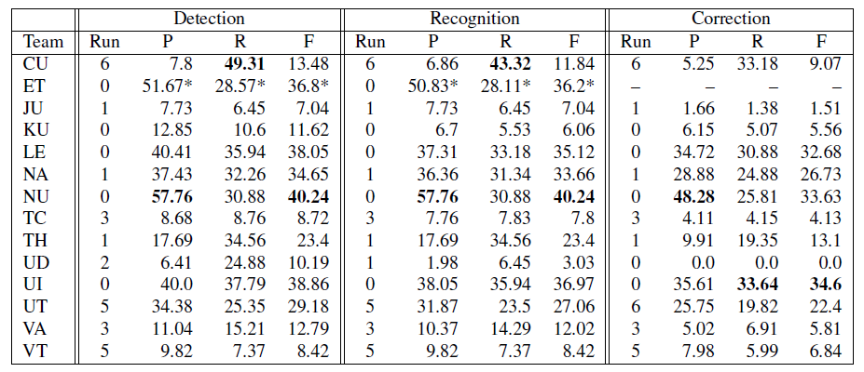
Determiners

Slide 18
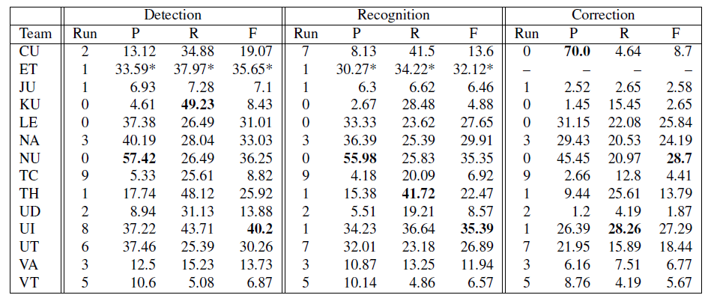
Prepositions and Determiners

Slide 19
Approaches Taken
Maximum Entropy classifier [ET, KU, LE, NA, TH]
Naïve Bayes classifier [CU, TC, UI]
N-gram LM [ET, JU, VT]
Rule-based component [ET, JU, LE]
Decision-tree classifier [UT, VA]
Average Perceptron classifier [UI]
Confidence-weighted linear classifiers [NU]
CRF tagger [TH]
SVM classifier [UD]

Slide 20
Data Used
FCE data as provided [CU, KU, LE, NA, TC, UI, UT, VT]
Google 1T [ET, UD, UI, UT, VA]
BNC [LE, UT, TH]
FCE data corrected [LE, NU]
Google Books n-gram corpus [TC]
Reuters [LE]
Complete FCE dataset* [CU]
San Jose Mercury News and MetaMetrics Lexile corpora* [ET]

Slide 21
Features Used
Lexical items [ET, KU, LE, NU, UI, UT, TC, TH, VA]
POS tags [ET, KU, LE, NU, UD, UI, UT, TC, TH]
Phrase-chunk based features [ET, KU, LE, NU, UD, UI, UT, TH]
Parse-based features [CU, KU, NA]
Web counts [UD, NU]
Original article [UI]
Word clusters [UT]
Noun countability [UT]
Dependency n-gram counts [NU]
Learner’s L1 [KU]
Length+ending encoding [VT]

Slide 22
Overview
Background: The HOO 2011 Pilot Round
The HOO 2012 Prepositions and Determiners Challenge
Results
Conclusions

Slide 23
Outcomes
A high-participation shared task with an emphasis on public data sets and replicability
A set of freely-available flexible tools for evaluating a wide range of text-level error correction tasks
A benchmarking dataset
See www.correcttext.org to get the tools and the existing data sets

Slide 24
Limitations and Issues
Hard to get data, expensive to construct
Annotation errors and disagreements
Is it valid to look at one or two error types in isolation?

Slide 25
Thank you to:
Cambridge University Press
the BEA organisers, and
all the participants for taking part

